Slide 1

Air Quality Prediction – Insights for Environmental & ML Analysis
Power BI & Machine Learning – Driven Environmental Analysis
Unmit Patel
Notes:
I’ll walk you through a data analytics and machine learning driven air quality system project.
Explain how I integrated model predictions, confidence, and diagnostics into a Power BI dashboard designed for decision support

Slide 2

Problem Statement and Objective
Problem Statement
Air quality assessment is often reactive, fragmented, and hard to interpret
Stakeholders need early warnings, not just historical reports
Objective
Predict air quality levels: Good, Moderate, Poor, Hazardous
Identify key environmental drivers
Evaluate model accuracy, confidence, and reliability
Enable decision support, not just model evaluation
Notes:
Purpose:
Address challenge in air quality monitoring.
Most systems are reactive and focus only on historical reporting
Objective:
Wanted to build predictive and explainable system that forecasts air quality.
Helps stakeholders understand why conditions deteriorate.
How much they can trust the predictions.
Design:
The dashboard is designed as a decision – support system, not just a model performance report.

Slide 3
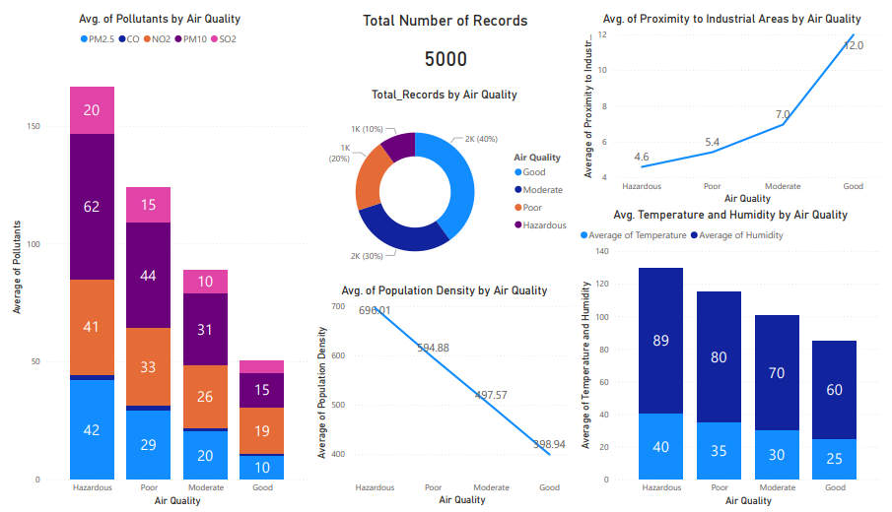
Key Environmental and Urban Drivers of Air Quality
Key Factors Influencing Air Quality
Pollutants: PM2.5, PM10, CO, NO₂, SO₂
Climate: Temperature, Humidity
Urbanization: Population Density
Industry: Proximity to Industrial Areas
Key Insights
Air quality degrades sharply with higher pollutant values and dense urban regions
Notes:
Slide focuses on what drives air quality deterioration
Total records are 5000. Dataset not too big
Donut chat:
Shows distribution of air quality in dataset
40% of air quality is good air quality
30% of air quality is moderate
20% of air quality is poor
10% of air quality is hazardous
Bar graph on left side:
Increase in particulate pollutants like PM2.5 and PM10 leads to air quality deterioration
Same goes for gaseous pollutants like NO2, SO2, and CO
Bar graph on bottom right:
As the air quality becomes worse, temperature and humidity increases
Line chart on Top right:
Increase in proximity of Industrial area improves air quality.
Related to real – world expectations.
Line chart in between at bottom:
It shows linear relationship.
Resembles impact of urbanization.
Air quality worsens as population density increases.
Insights:
Air quality degradation is systematic.
Driven by environmental and human factors.

Slide 4
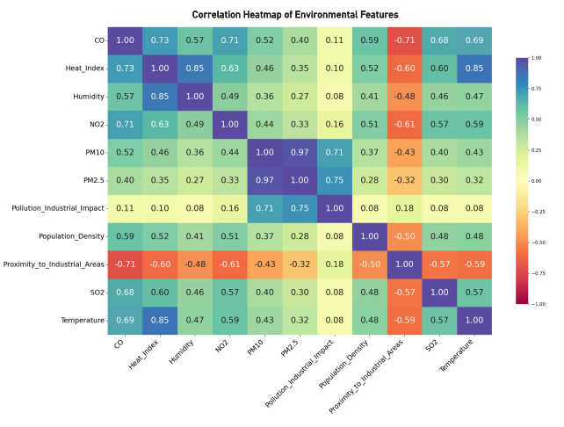
Understanding Relationships Between Environmental Features
Correlation analysis helps to validate feature interactions
Strong Positive relationships:
PM2.5 and PM10
Temperature and Heat Index
Industrial Impact and particulate matter
Negative Correlation:
Proximity to Industrial areas vs. Air Quality Indicators
Why This Matters
Confirms non-linear and interdependent relationships
Justifies use of tree – based ML model (XGBoost)
Improves model interpretability and trust
Notes:
This slide shows relationship of features
I analyzed relationships between features to understand how they interact
Strong Positive Relationships:
PM2.5 and PM10 : 0.97
Heat Index with Temperature and Humidity: 0.85
Industrial Impact with particulate matter like PM2.5 and PM10: 0.75 and 0.71 respectively
Negative Correlation:
Proximity to Industrial areas with Air Quality Indicators
Insights:
Non-linear relationships
XGBoost model is best choice when it comes to generalization and capturing non-linear relationships
This improves interpretability and builds confidence with feature engineering

Slide 5
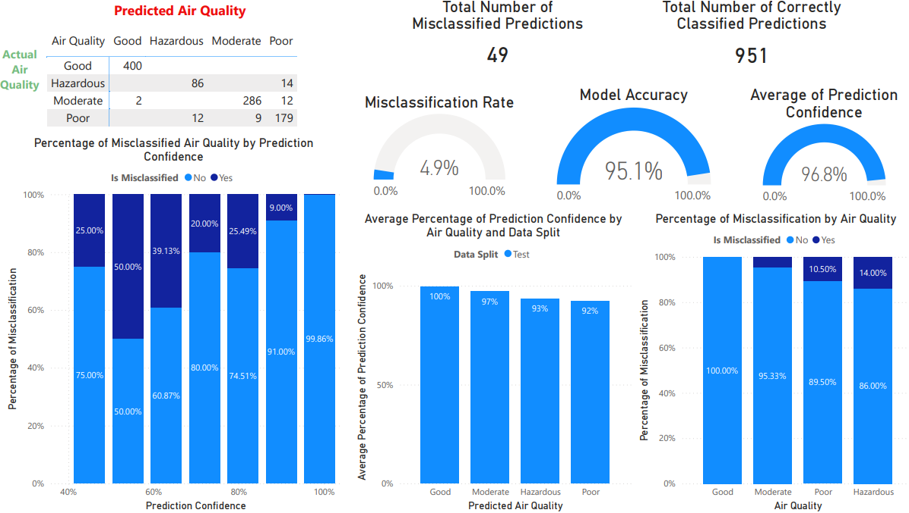
Model Performance & Prediction Reliability
Model Performance:
Accuracy: 95.1%
Misclassification Rate: 4.9%
Average Prediction Confidence: 96.8%
Correctly Classified Predictions: 951
Misclassified Predictions: 49
Reliability Insights
High confidence across most predictions
Errors are systematic, not random as they occur on borderline cases
Strong generalization from train to test data
Notes:
This slide focuses on the performance of XGBoost predictive model
All the results are based on model’s performance on unseen data
Dataset was split into 80:20 ratio. 80% (4000) being training data and 20% (1000) as testing data.
Model achieves 95.1% accuracy
Misclassification rate of 4.9%
Average prediction confidence of 96.8%
Out of 1000 unseen records, 951 air quality are correctly classified.
49 are misclassified.
Confusion matrix on top left:
Shows that most errors occur in boundary cases between Moderate, Poor Hazardous categories
Bar graph below matrix:
As prediction confidence improves misclassification reduces.
Bar graph in middle:
Shows how confident model is with its prediction for each class
100% confident with good air quality
Confidence reduces as air quality deteriorates.
Bar graph in bottom right:
Shows which class model finds hard to learn?
Model understand Good air quality by 100%
Struggles as the air quality deteriorates.
Insights:
Prediction confidence correlates with model’s efficiency to learn each class.
High confidence for majority of predictions
Errors are systematic, not random as they occur on borderline cases
Model generalizes very well with minimal overfitting

Slide 6
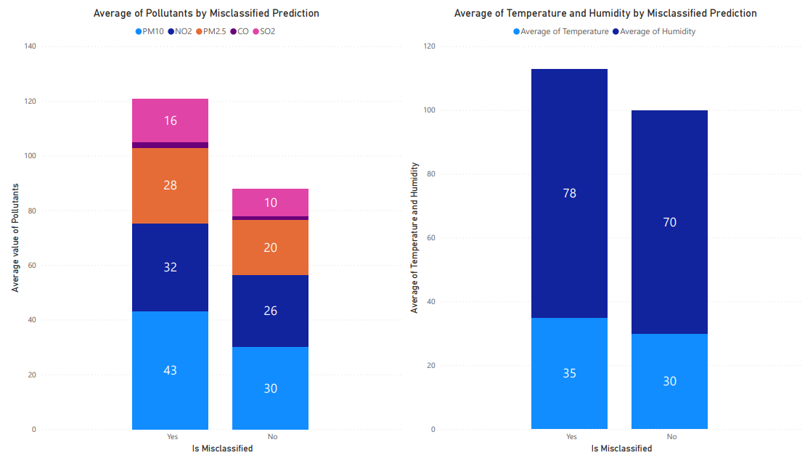
Risk Analysis and Actionable Insights
Error and Risk Analysis
Misclassification occur in:
Borderline environmental conditions
Extreme pollution scenarios
Higher pollutant levels increase uncertainty
Actionable Outcomes
Flag low – confidence predictions for human review
Enable risk – aware monitoring
Support targeted environmental interventions
Improve responsible ML deployment
Notes:
This slide shows where the model struggles
Misclassification tends to occur under extreme or borderline environmental conditions.
Pollutant concentrations and climate factors are usually high.
Actions can be taken:
Set alerts on low – confidence predictions for human review
Enable risk – aware monitoring
This is crucial for responsible ML deployment

Slide 7
Who benefits & why it matters
Who can use this Analysis
Data and ML Teams: model monitoring and validation
Government and Policy Makers: early warnings, pollution control
Public Health Agencies: health advisories
Environmental Organizations: monitoring and compliance
Key Value
Predictive and Explainable
Confidence aware
Scalable and decision focused
Notes:
Who can use this Analysis?
Data and ML teams can track model performance, confidence, and drift
Government and policy makers can use it for early warnings and targeted improvements
Public health agencies can perform health advisories when Air Quality is predicted as Poor or Hazardous
Conclusion:
this project demonstrates how machine learning can be Integrated with analytics to create a transparent, trustworthy decision support system

